Slide 1


Communication Skills part 1
Week 4: Feelings/thoughts,
Cohesion & coherence - 2

Slide 2
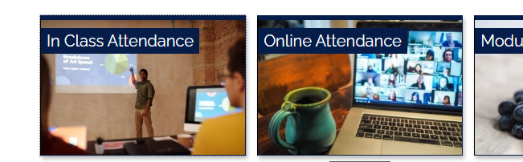

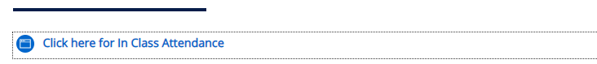

Registering your in Class attendance
Step 1: Ensure you are logged into the ARUL-Wi-Fi.
The password is: 1nt3rn3t@Arul
Step 2: Login to the VLE and go to the module page for your class.
Step 3: Click on In Class attendance
Step 4: Click on the link highlighted in blue. The word submitted will appear on your screen if you have followed the procedure
Step 5: Repeat this process for your PM/AM class
Notes:
Get all students to register their attendance for todays WW session
This is the process they will follow for attending classes next week, but they need to select the module they will be studying

Slide 3

Learning outcomes:
By the end of this session, you will have:
Discussed the second element in Gibbs’ reflective model – Feelings/thoughts.
Discussed how reference words can improve the cohesion of your work.
Identified and practiced strategies to improve coherence and cohesion in written texts.

Slide 4
Homework 2 - Reading
Last week, you were asked to read pp. 39-48 (A reflective diary or learning journal) in your coursebook ‘Reflective Writing.’
Discuss the following in groups of 3 or 4.
According to the authors, what kind of information are students of creative subjects likely to write in their journals?
How do learning journals help one develop their practice as a professional?
There are parts of journal entries in the book from students of three subjects – education, nursing and medicine. How are they different from and similar to each other?

Slide 5

Element 2. Feelings and thoughts

Slide 6

Last week we discussed the first element in Gibbs’ model of reflection – Description. Today, we are looking at the second element – Feelings and thoughts.

Slide 7
Feelings and thoughts - before, during and after
Here you can explore any feelings/thoughts that you had before, during, and after the experience and how they may have impacted the experience.
Helpful questions:
What were you feeling before, during and after the situation?change feelings
What do you think other people were feeling about the situation?
What do you think other people feel about the situation now?
What were you thinking during the situation?
What do you think about the situation now?
Notes:
Source: https://www.ed.ac.uk/reflection/reflectors-toolkit/reflecting-on-experience/gibbs-reflective-cycle

Slide 8

Example – feelings and thoughts
Open Week 4 worksheet and go to Activity 1. Read the example paragraph of Feelings/thoughts.
Work in pairs / groups and discuss the questions in activity 1.
Sample answers may be provided by your lecturer.

Slide 9
Words of feelings
On your laptop, or on paper, write as many words as possible to express feelings (e.g., exhausted, happy…). You have 2 minutes.
After 2 minutes, work in groups of 3 or 4 and look at the words that have been written. Who has written the most in class?
Are they all adjectives? How many of them are positive? How many have negative connotation? How many can be neutral?
Can you classify them in any other way? For example, gradable and non-gradable?
Source

Slide 10


Words of feelings – synonyms and antonyms
Open Week 4 worksheet on VLE and go to Activity 2.
Complete the table with the synonyms and antonyms of the given words of feeling. You may use a dictionary.
When it is done, work in pairs/groups and compare your answers and discuss the meaning of any new words.

Slide 11
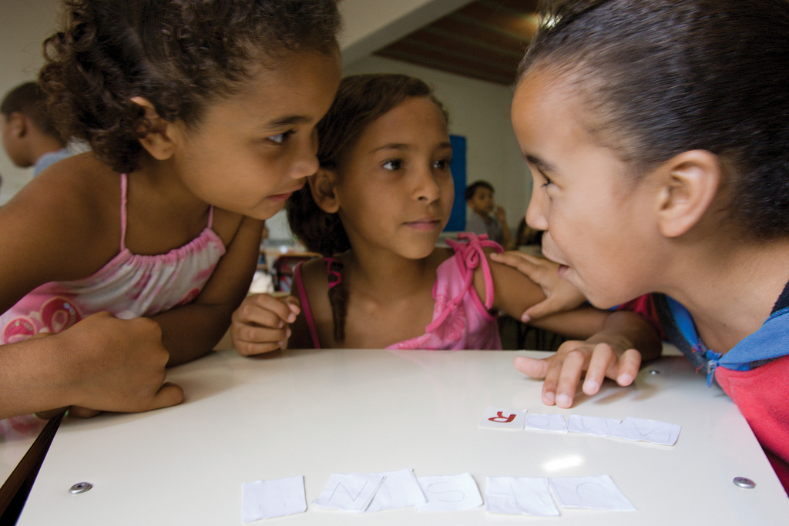
Game time
Let us now use / review words of feelings using an activity on Kahoot.
Listen to Lecturer’s instructions.

Slide 12
Think – Pair - Share
Choose something you did yesterday or today (or a situation you were in, or an event you went to). Then think:
How did you feel before, during and after the event / situation? What were you thinking before, during and after it? How did your feelings and thoughts affect your experience? How are you feeling about it now? How did others feel (if someone else was involved)?
Now, work in pairs and tell each other about your feelings / thoughts and their impact.
Finally, work in groups or as a whole class and share your feelings/thoughts and their impact.

Slide 13
Independent writing - Week 4
Last week, you wrote the DESCRIPTION element of your RW.
This week, write the Feelings/Thoughts element on the aspect you have chosen for your assignment. The word count for this is 225.
Materials and activities used in your lessons/lectures
ARUL campus facilities and amenities
Involvement and participation in your lessons/lectures
Bring your work to the next lesson so we can look at it and give you some feedback.

Slide 14

Break: max. 15 mins

Slide 15

Coherence and cohesion - 2

Slide 16

Reference words

Slide 17
Work in pairs. Is this paragraph coherent? Why/not? How would you rewrite the text?
Leonardo da Vinci (1452-1519) was a fifteenth-century Italian genius who produced only a few finished artworks. However, the finished artworks include the Mona Lisa and The Last Supper, the Mona Lisa perhaps the most famous painting in the world.
Although she(he) is remembered mainly as an artist,
He was also an engineer and scientist. His designs include tanks and flying machines, and although few of the designs were built in his lifetime, he is still remembered as the man who saw the designs' possibility. Since his death in 1519, there has not been a time where his achievements, diverse interests and personal life have failed to incite interest and admiration, making it a frequent subject and namesake in culture.
Bailey, 2022
Notes:
Answer to this activity is in the lecturer version worksheet.

Slide 18
Common reference words - examples
Reference words generally include pronouns – the most common examples are:
She / he / hers / his
It / they / them
This / that
These / those
The former / the latter / respectively
Who / which / that
One / one’s
Such
Do you know them all? If not, do some independent research to learn about the new reference words.

Slide 19
Activity 3: Reference words
Go to Activity 3 – Reference words worksheet.
Decide which words should be replaced with reference words. (Please note that one answer doesn’t feature in the list – you’ll need to work this out for yourself based on what you’ve just learned.)
Re-write the paragraph (including reference words).

Slide 20

In-class writing practice

Slide 21
Homework 1 - Writing
Your homework was to write the DESCRIPTION element of your RW on one of the following topics:
Materials and activities used in your lessons/lectures
ARUL campus facilities and amenities
Involvement and participation in your lessons/lectures
Work in pairs and look at each other’s work. Tell your friend what you like about their work and how they can do even better. Have they described:
When and where did the event / situation happen? Why were they there?
Who was present? What did they and the other people do?
What happened? What did they want to happen?
What was the outcome of the situation?

Slide 22


Slide 23
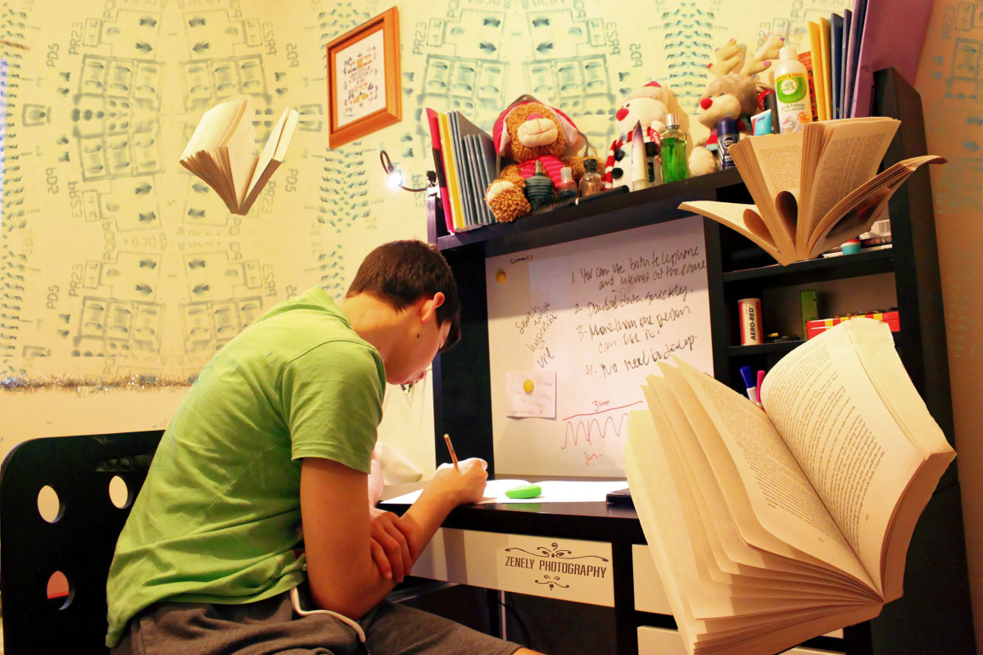
Independent study – Week 4
Go to the ‘Independent study’ section under the Week 4 tile.
READ: pp. 24-28 (Reflecting on yourself and your experiences). Click on the link on VLE or open the PDF on VLE.
ANSWER: Homework Quiz 4 on VLE (To be completed after reading pp. 24-28).
WRITE: Week 4 Independent Study Writing Activity (Check Week 4 on VLE).
Preparation videos for Week 5.

Slide 24
References
www.arts.ac.uk/pre-sessional-English-core-materials.html Bailey, S., 2017. Academic Writing: A Handbook for International Students. 5th ed. s.l.:Routledge. BBC, 2021. Presentations: language expert. [Online] Available at: https://www.bbc.co.uk/worldservice/learningenglish/business/talkingbusiness/unit3presentations/expert.shtml [Accessed 29 September 2021]. Rochester Institute of Technology, 2021. Reference Words. [Online] Available at: https://www.rit.edu/ntid/sea/processes/referencewords/intro [Accessed 29 September 2021]. Massey University, 2021. Signpost words and phrases. [Online] Available at: https://owll.massey.ac.nz/pdf/studyup-essays-2-handout.pdf [Accessed 29 September 2021]. https://www.ed.ac.uk/reflection/reflectors-toolkit/reflecting-on-experience/gibbs-reflective-cycle https://create.kahoot.it/details/d21f60f8-a811-4f41-91af-2cd69033122c www.Sheffield.ac.uk/eltc https://www.canterbury.ac.uk/students/docs/study-skills/resource-8-Signposting-Words.pdf www.cambridgeenglish.org/learning-english/activities-for-learners/b1w005-linking-words University of Hull, 2021. Signposting. [Online] Available at: https://canvas.hull.ac.uk/courses/371/pages/signposting [Accessed 29 September 2021]. University of Southampton, 2021. Coherence and cohesion (online). Available at www.ed.ac.uk/reflection/reflectors-toolkit/reflecting-on-experience/gibbs-reflective-cycle

